Slide 1
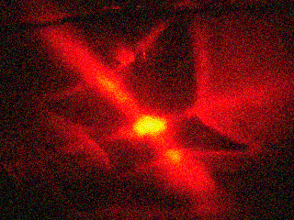
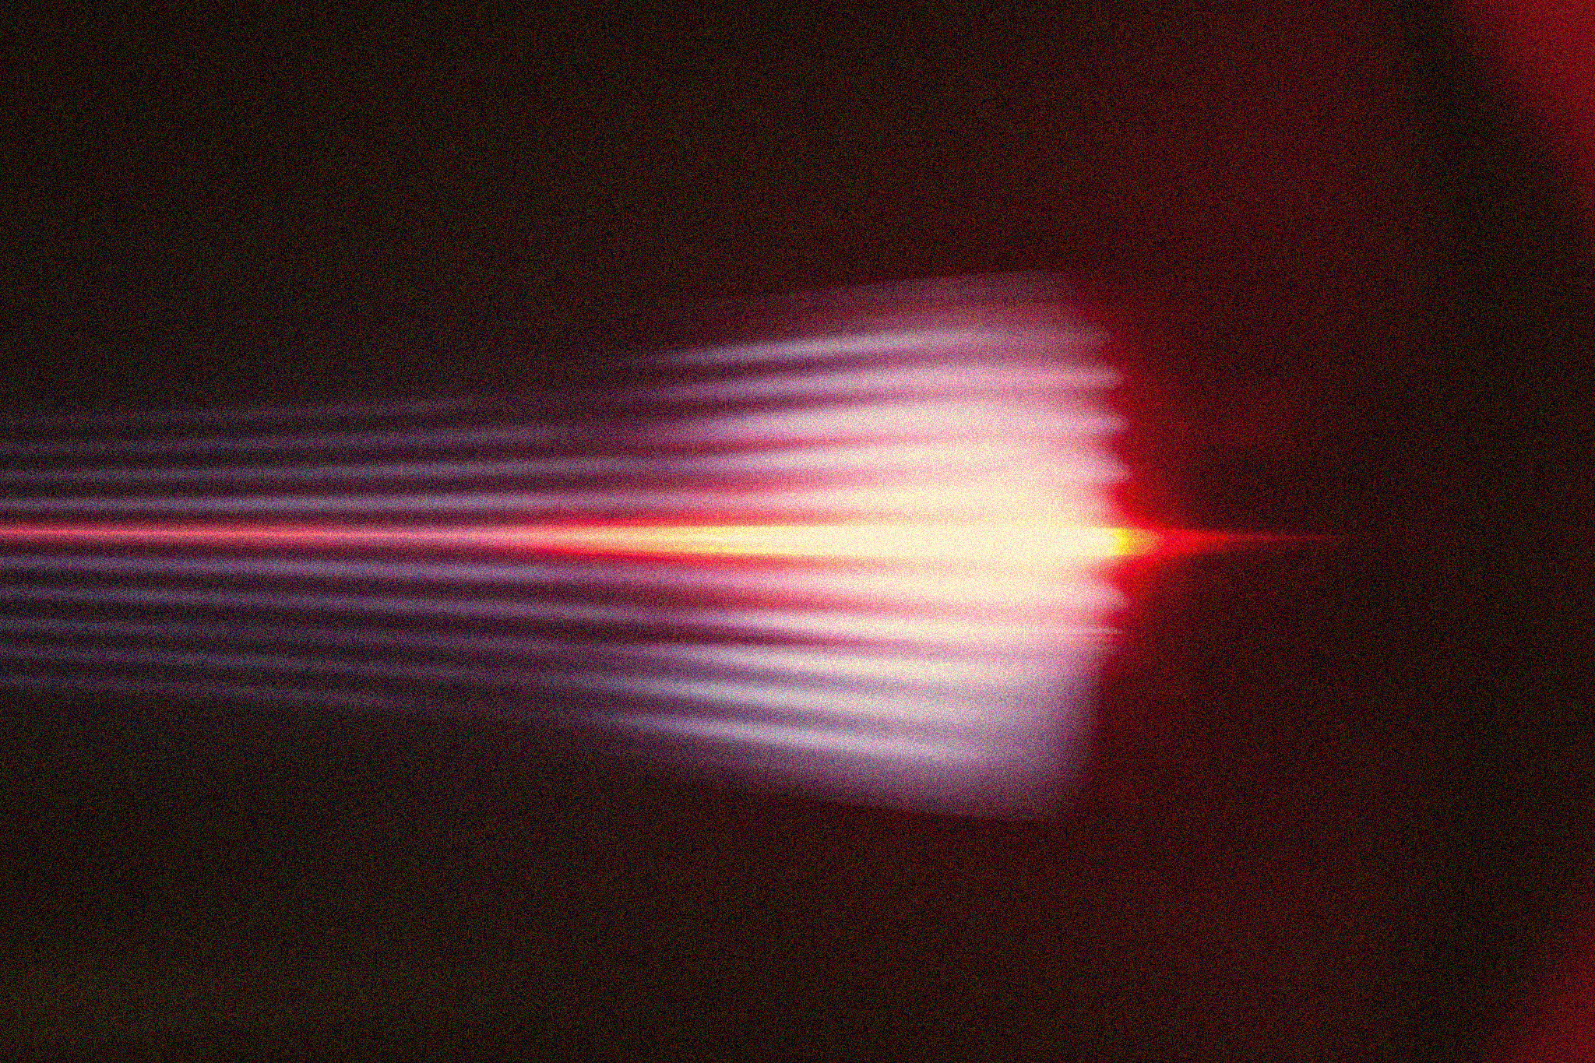
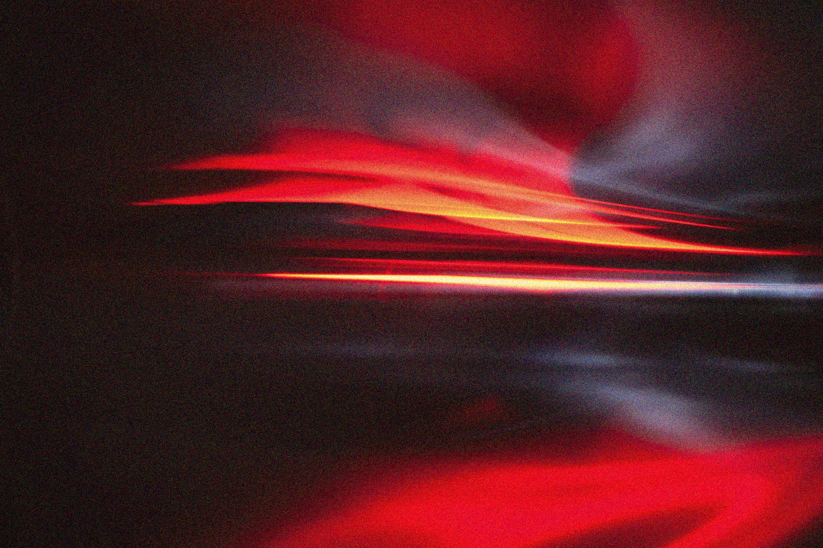
APP PHYSICS 157
COMPUTATIONAL ANALYSIS AND MODELLING
PROPERTIES AND APPLICATIONS OF THE 2D FOURIER TRANSFORM
IMAGE AND VIDEO PROCESSING – MODULE 1
NINO PHILIP RAMONES | GITHUB
2020 – 05616
APRIL 21, 2023
This Photo by Unknown Author is licensed under CC BY-NC-ND

Slide 2
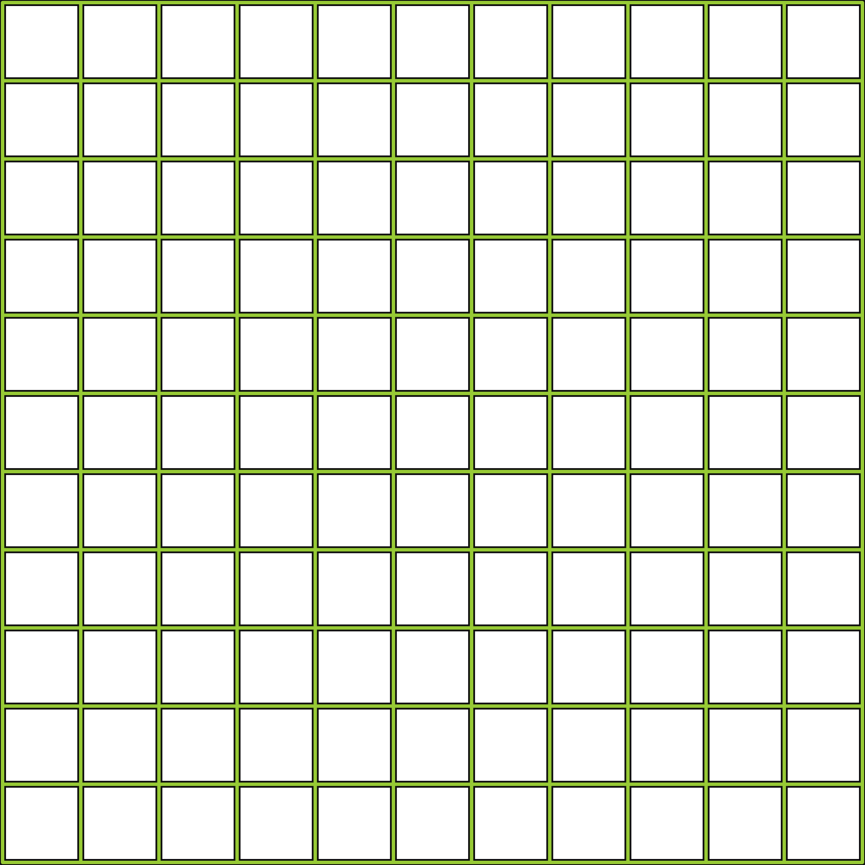
APP PHYSICS 157
PROPERTIES AND APPLICATIONS OF THE 2D FFT
OBJECTIVES
Observe the rotation property of two-dimensional Fourier transform and examine how it comes into play in simulating patterns in images
Explore some of the different applications of Fourier transform in filtering frequencies in Fourier space
KEY TAKEAWAYS
Similar to the previous activity, setting your image resolution to any powers of two will greatly speed up the calculation process when subjected to FFT algorithms and filtering
Investigate the convolution theorem redux of some pair apertures
The FFT algorithm comes into play when filtering unwanted frequencies or signals, which is useful in altering the appearance of images
SOME PITFALLS
The pattern that must be convolved must be of the same size as it processes both images by checking and comparing it pixel by pixel
The choice of mask for filter affects the apperance of the resulting filtered image

Slide 3
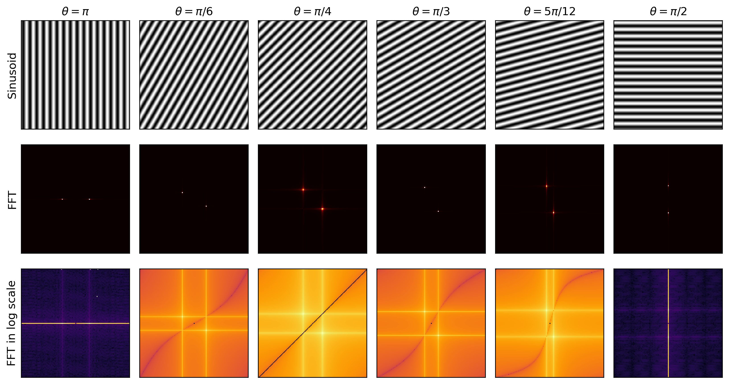
APP PHYSICS 157
PROPERTIES AND APPLICATIONS OF THE 2D FFT
ROTATION PROPERTY OF FFT
Figure 1. Rotation of sinusoids from 90 degrees to 180 degrees and their FFTs.
From the previous, the FFT a sinusoid results to a two dots or peaks in the Fourier space. The rotation property is unique to 2D Fourier transforms as rotating the sinusoids in the real space results to their FFTs being rotated as well. In general, the FFTs are rotated by about 90 degrees from their orientations in the real space, which will be of much use in the latter activities as it can be combined to simulate an imaging pattern seen in real life!

Slide 4
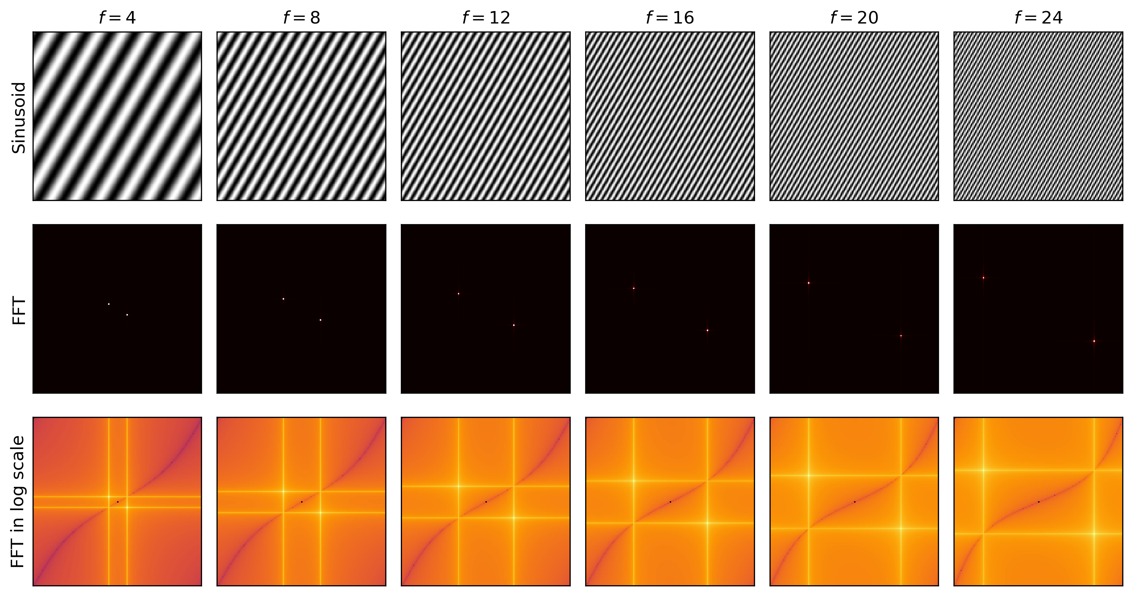
APP PHYSICS 157
PROPERTIES AND APPLICATIONS OF THE 2D FFT
ROTATION PROPERTY OF FFT
Figure 2. Sinusoids of varying frequencies and their FFTs.
Similarly, increasing the frequencies of a rotated sinusoid – which in this case is rotated by 45 degress – results to their FFTs being rotated as well with varying dot spacings in the Fourier space. It also be noted that the origin in Fourier domain represents the zero frequency by which is also symmetric on both axes. Thus, increasing the frequency in the real space will result to a larger separation between the two dots.

Slide 5
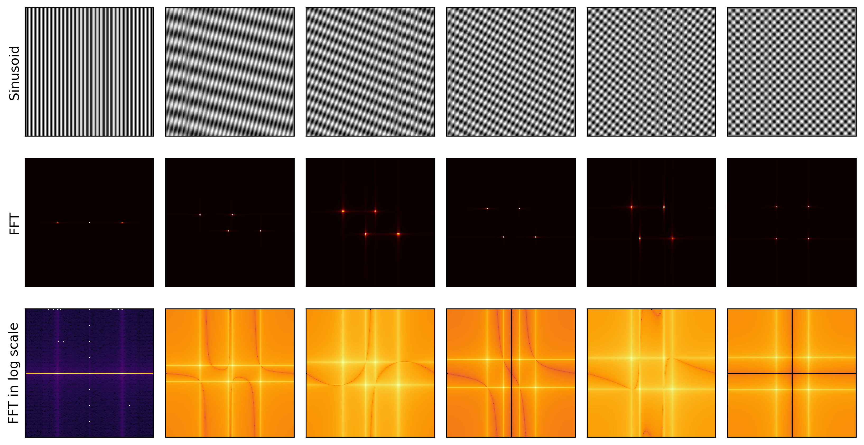
APP PHYSICS 157
PROPERTIES AND APPLICATIONS OF THE 2D FFT
COMBINATION OF SINUSOIDS
Figure 3. Product of two sinusoids at different rotation angles and their FFTs. Frequency of 4 were used for all sinusoids.
Taking the product of two sinusoids of the same frequency or taking their squares operation-wise resulted to an interesting property. Since the product of two sinusoids can be decomposed as sums of sines or cosines, the latter of which can be represented by a certain phase shift, these also deconstruct into their respective frequencies in the Fourier space. Hence, instead of just one pair of dots for a single sinusoid, two pairs were observed in the FFT as it represents the two sinusoids being added together.

Slide 6
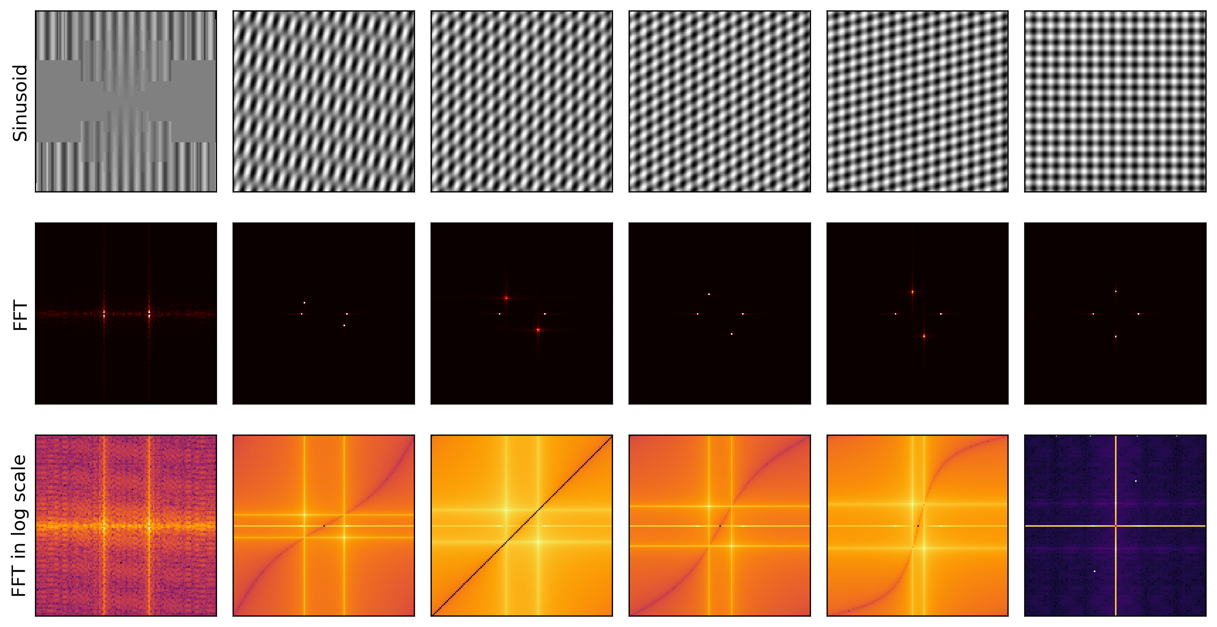
APP PHYSICS 157
PROPERTIES AND APPLICATIONS OF THE 2D FFT
COMBINATION OF SINUSOIDS
Figure 4. Sum of two sinusoids at different rotation angles and their FFTs. Frequency of 4 were used for all sinusoids.
Similar two the product of two sinusoids, taking their sums also produce a pattern that follows a similar pattern to the previous. From the figure, notice that adding sinusoids in the spatial domain results into their respective deconstructed frequencies in the Fourier domain. As such, it can be observed that combining sinusoids together results to a pattern that resembles a weaving pattern or repeating microscopic patterns! This is where the applications of FFT comes in as a rich structure can be noted from the FFT of such patterns seen in the Figure 4.

Slide 7
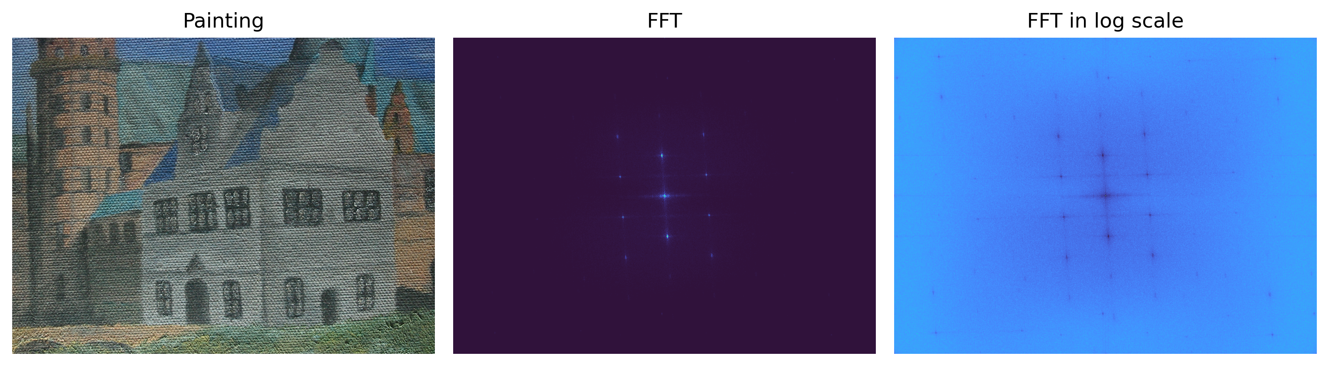
APP PHYSICS 157
PROPERTIES AND APPLICATIONS OF THE 2D FFT
CANVAS WEAVE MODELLING
Figure 5. The original painting of interest and its FFT. Image used is the Painting by Daria for reference.
For this part of the activity, we begin by converting the painting into grayscale and taking its mean value. This was done to remove the DC bias of the image which can be ruled to affect the analysis later on. The corresponding FFT of the mean grayscale painting was carried out and we can see the peaks much more in the logarithmic scale. These peaks can be interpreted as the sinusoids that are combined to resemble the weaving pattern of the canvas itself. Since we want to remove the canvas weave and obtain a cleaner image, we can remove these unwanted patterns in the canvas by “masking” the peak frequencies in the Fourier domain.

Slide 8
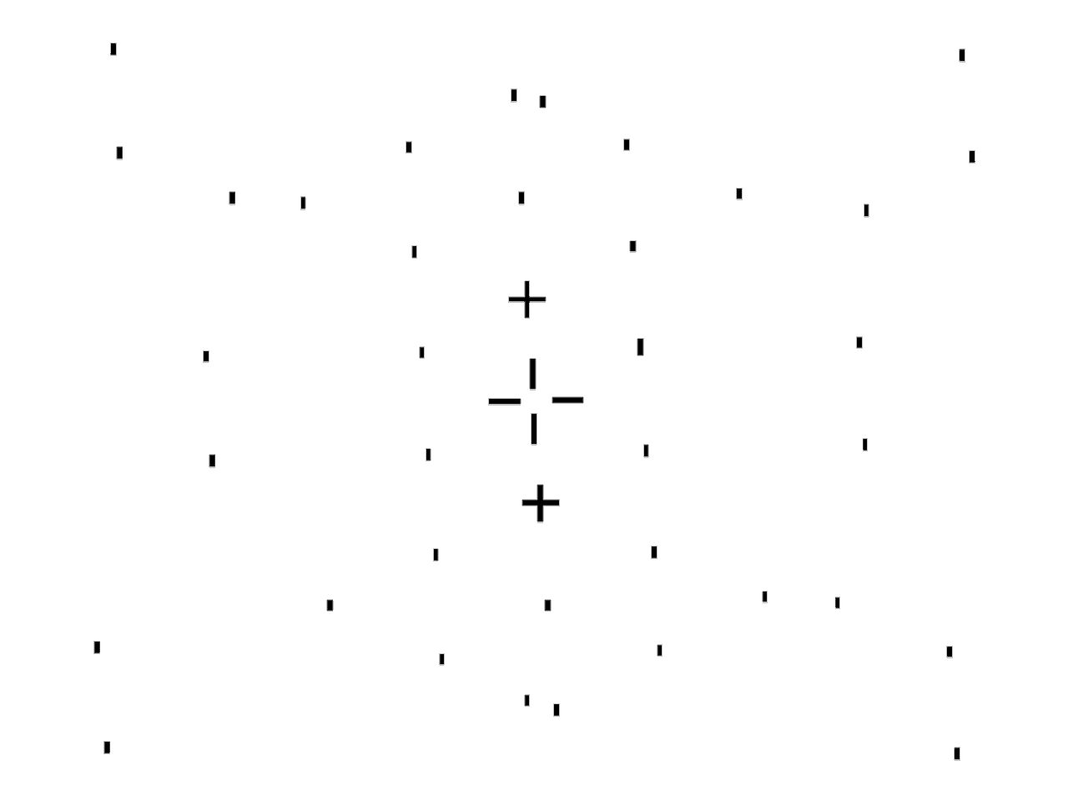
APP PHYSICS 157
PROPERTIES AND APPLICATIONS OF THE 2D FFT
CANVAS WEAVE MODELLING
Figure 6. Filtered mask used in the activity.
After obtaining the FFT of the painting, a filter mask in the Fourier space was manually created. This mask is of the size as the image and is all ones but are zeros at the locations of the sinusoidal peaks. The FFT shift of the filter in Figure 6 was obtained and was multiplied to the FT of the RGB channels of the original painting image. The resulting products was subject to the invest FFT algorithm and were stacked together to resemble the modified RGB channels of the new image. The resulting image were expected to be much cleaner than the original and is almost free of the canvas weaving pattern!

Slide 9
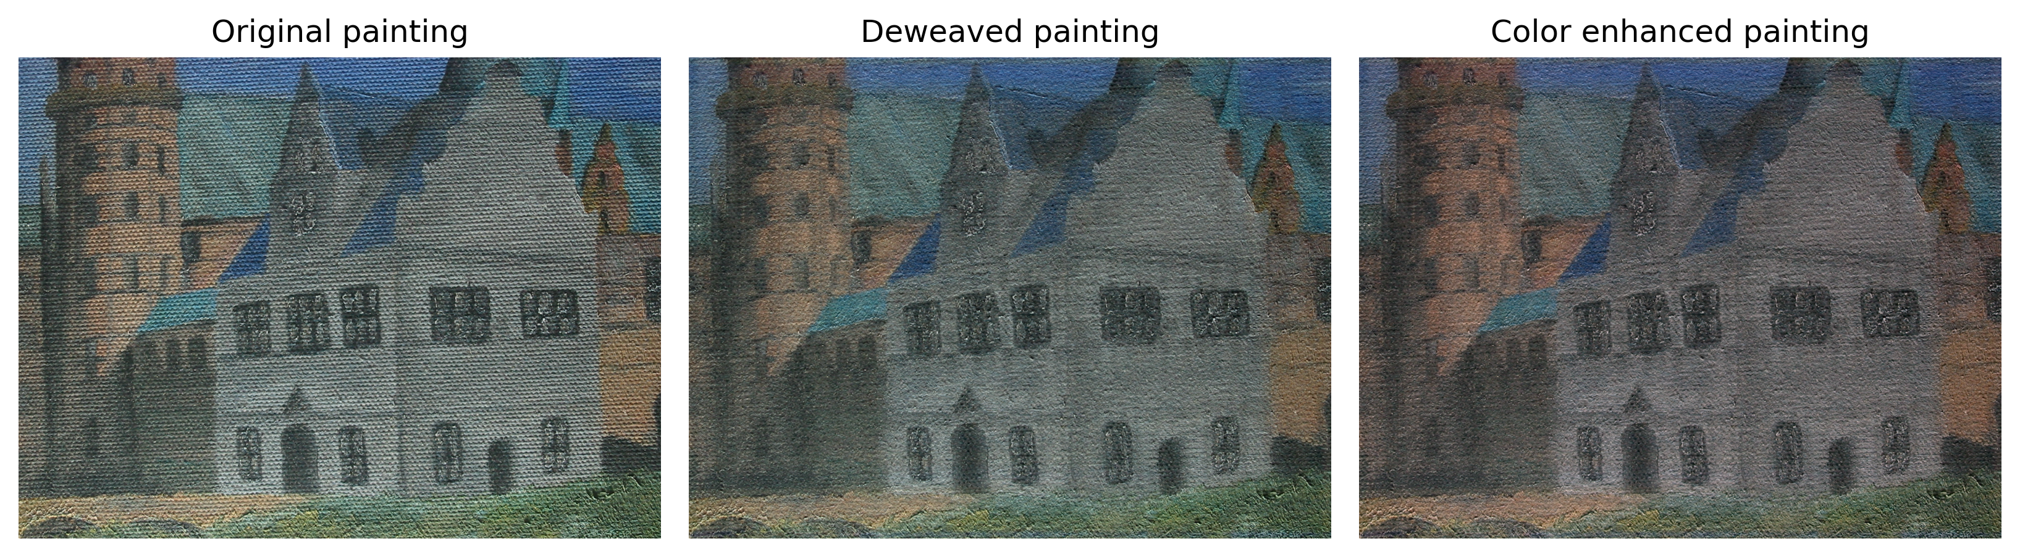
APP PHYSICS 157
PROPERTIES AND APPLICATIONS OF THE 2D FFT
CANVAS WEAVE MODELLING
Figure 7. Final results after isolating the canvas patter from the original painting and white balancing the cleaned image.
Using the algorithm briefly explained in the previous slide, the unwanted frequencies from the canvas weaving pattern were filtered out and a much cleaner painting were obtained. The appearance of the deweaved painting could still somehow be improved with the choice of mask, but a stark contrast between the original and deweaved one was still obvious! In addition, the gray world algorithm (GWA) from the first activity was used to balance the color of the resulting image further. GWA was used since an apparent gray color was dominant on the painting – the color of the walls of the building -- by which the average reflected color of the painting was estimated and compared to gray color (Maulion, 2021).

Slide 10
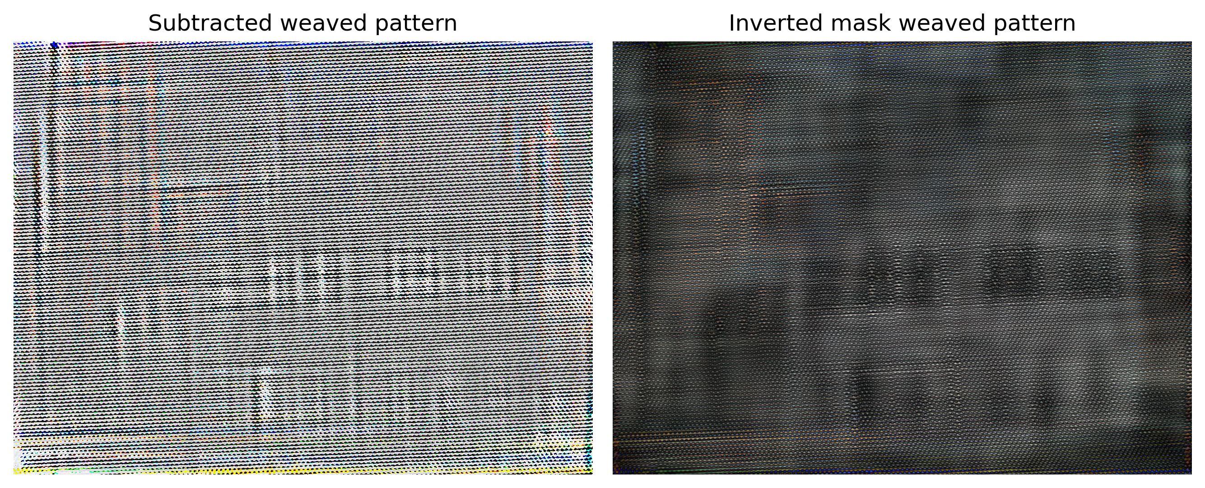
APP PHYSICS 157
PROPERTIES AND APPLICATIONS OF THE 2D FFT
CANVAS WEAVE MODELLING
Figure 8. Isolated canvas weaved patterns after masking.
To further validate our results, we subtract the resulting image to the original one to retrieve the canvas pattern. As expected, ragged surfaces were observed that closely takes the form of the patterns! Similarly, taking the inverse of the mask from Figure 6, i.e. all ones becomes zero and vice versa, and feeding it into the coded algorithm also resulted to the retrieval of the sinusoidal patterns. By close examination, the patterns obtained were similar to each other (Yay!)

Slide 11
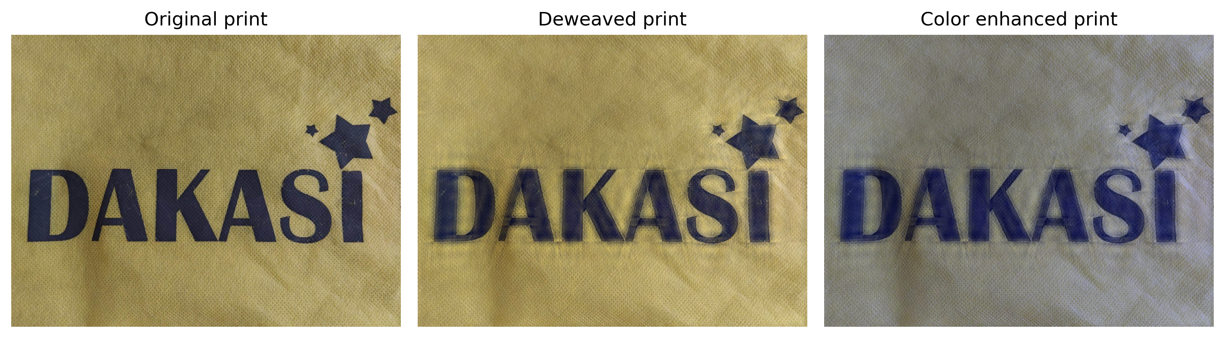
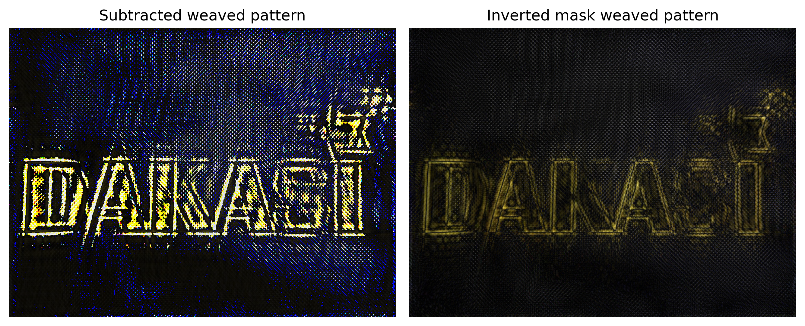
APP PHYSICS 157
PROPERTIES AND APPLICATIONS OF THE 2D FFT
CANVAS WEAVE MODELLING
Upon feeling inclined in doing the FFT algorithm for filtering unwanted frequencies in images, we also tried to isolate the weaving patterns of some common household material like ecobag. Employing the same algorithm used from the previous canvas, the following results were acquired. Room for improvement for the choice of mask must be considered!
Figure 9. Canvas weave modelling of an ecobag with print.

Slide 12
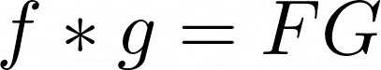
APP PHYSICS 157
PROPERTIES AND APPLICATIONS OF THE 2D FFT
Convolution Theorem [Revisited]
On the third part of the activity, we look into how the convolution theorem redux applies to convolving patterns. The algorithm is similar to what was previously done and recalling that the backbone of image convolution is simply the FFT. In the succeeding slides, we generally take note of the following:
The Fourier transform of a convolution of two functions f and g in space is the product of the Fourier transform of two functions F and G, i.e.
The convolution of a dirac delta at some point and a function results in the replication of that function in the location of the dirac delta, i.e.
We will revisit some of the interesting aperture geometries coded from the previous activity on Fourier transforms and see how convolution theorem governs the FFTs of such aperture combinations!

Slide 13
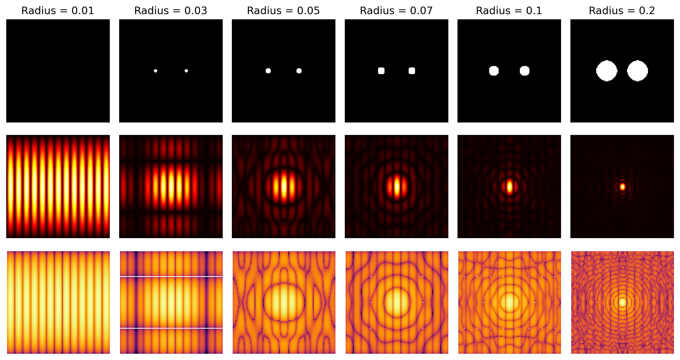
APP PHYSICS 157
PROPERTIES AND APPLICATIONS OF THE 2D FFT
Binary image of two dots
Figure 10. FFTs of two circular dots of varying radii.
From the previous activity, we know that the FFT of a sinusoid is two points similar to dirac delta functions. By the convolution theorem, taking the FT of two functions in real space must appear to be the multiplication of the FTs of the two functions. Since we know that the FT of a circular aperture is an airy disk, and the FT of two slits is like an enveloped sine, the FT patterns generally take the form of an airy pattern and a sinusoid, as expected!

Slide 14
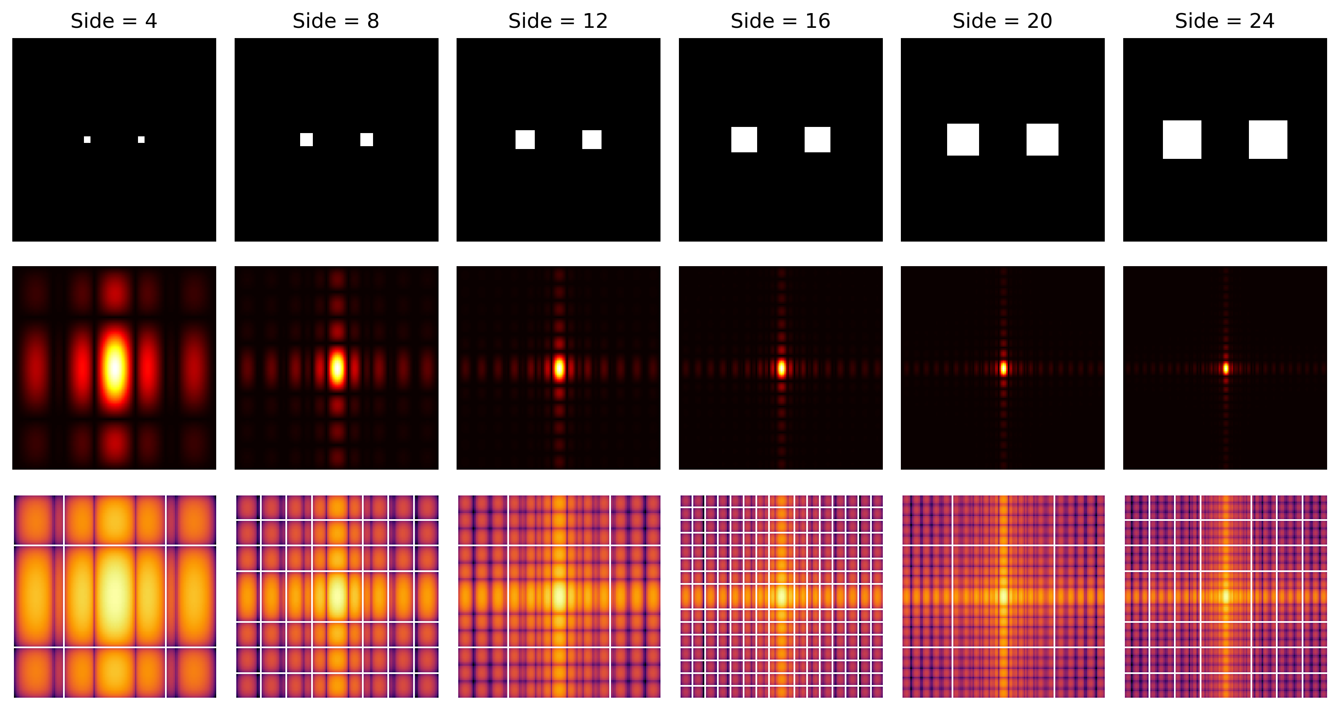
APP PHYSICS 157
PROPERTIES AND APPLICATIONS OF THE 2D FFT
Binary image of two squares
Figure 11. FFTs of two circular squares of varying sizes.
Similarly, we can recall from the previous activities that the FT of a square is an enveloped sine across the axes characterized by a bright band near the center. Since the FT of two dots is a sinusoid, taking the FFTs of two squares resulted to a combination of an enveloped sine across the axes and the pattern of the sinusoid in general – which is inherent for double slit apertures!

Slide 15
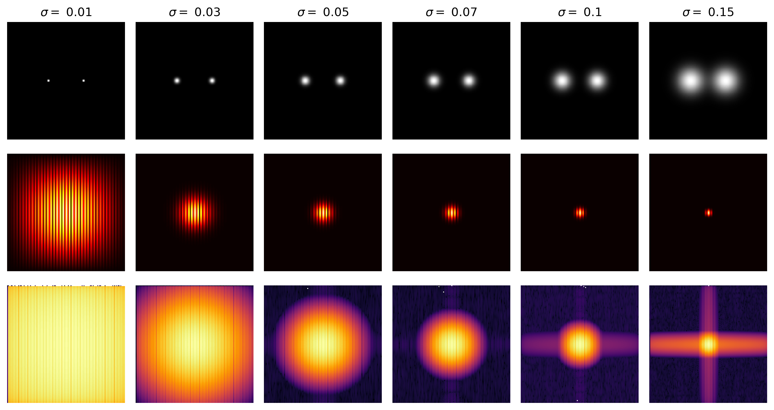
APP PHYSICS 157
PROPERTIES AND APPLICATIONS OF THE 2D FFT
Binary image of two Gaussians
Figure 12. FFTs of two circular Gaussian of varying spread values.
Interestingly, since the FFT of a Gaussian is also a Gaussian, the resulting FFTs of a Gaussian of varying spread parameter will always be Gaussian as well. Sinusoidal patterns enveloped inside the Gaussian FT were observed for two binary Gaussians since two dots in general will always yield a sinusoid, by the convolution theorem redux!

Slide 16
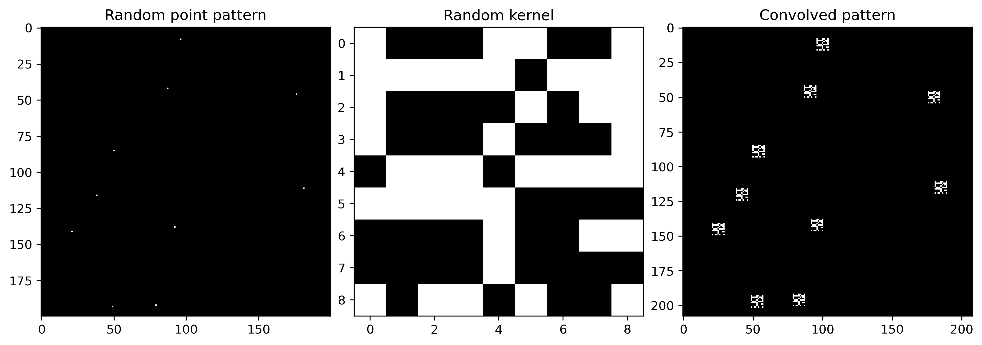
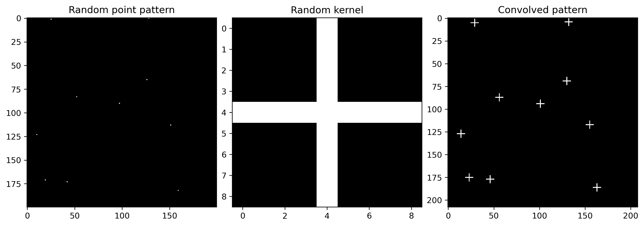
APP PHYSICS 157
PROPERTIES AND APPLICATIONS OF THE 2D FFT
Random point patterns
Figure 13. Random point patterns convolved with random kernels.

Slide 17
APP PHYSICS 157
PROPERTIES AND APPLICATIONS OF THE 2D FFT
Random point patterns
From Figure 13, random point patterns similar to dirac delts in space were set up in a 200 by 200 grid. A random kernel of patterns were also generated in a 9 by 9 array. Convolving a dot pattern with a such kernel produces an image where the kernel appears wherever the dots are, as expected, since convolution in 2-D space is a multiplication in Fourier space.
From the definition highlighted in the previous activities, the convolution is a smearing of one function against another, such that the resulting pattern looks a little like both the random dots and kernel.
Some note in this part: I used scipy.signal.convolved2d() function instead of the algorithm that was previously used on the activity since the random point pattern and kernel were not of the same size, which results to an error!

Slide 18
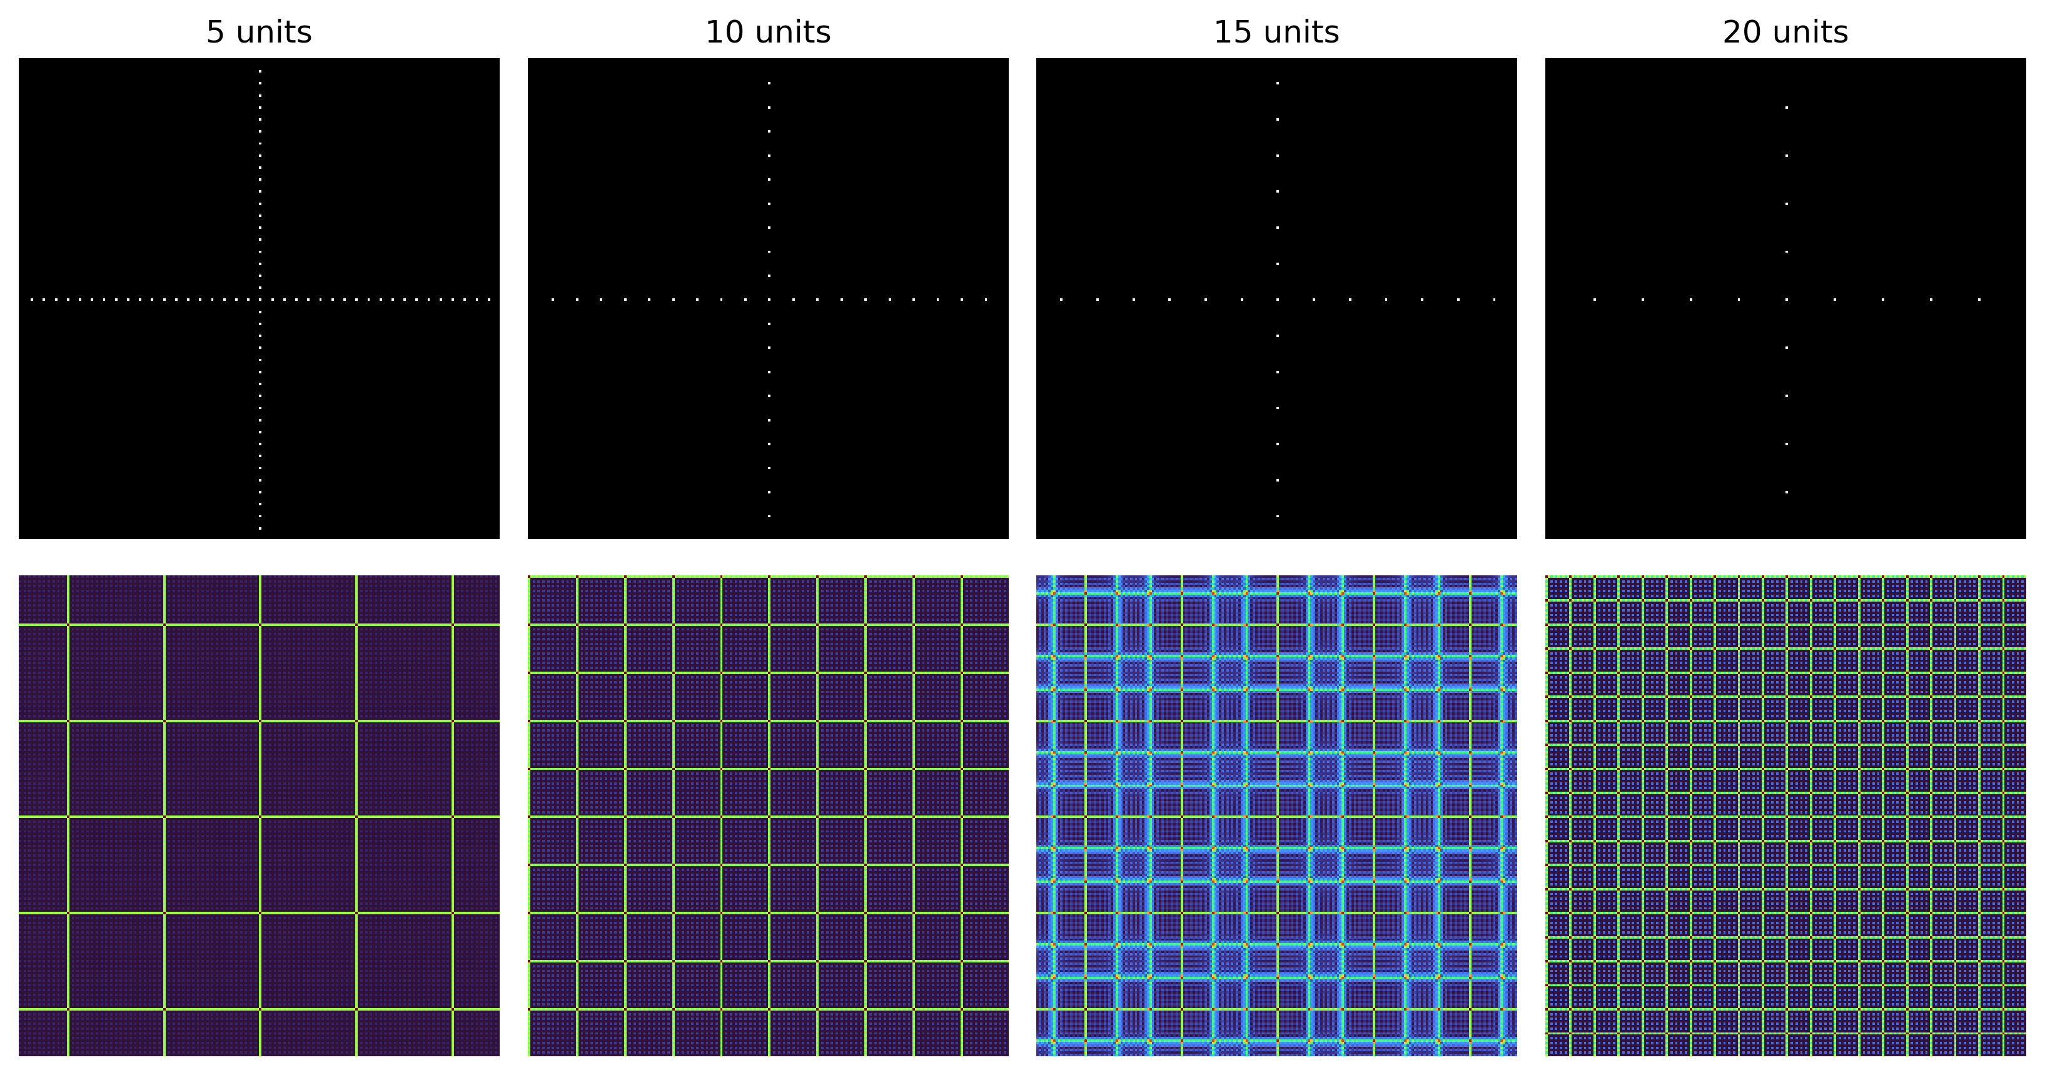
APP PHYSICS 157
PROPERTIES AND APPLICATIONS OF THE 2D FFT
More point patterns in space
Figure 14. FFTs of equally spaced dots along the axes for varying spacing values.
In general, the dots or peaks in the Fourier domain becomes closer to each other as the spacing of the dots increases across the axes in the space domain.

Slide 19
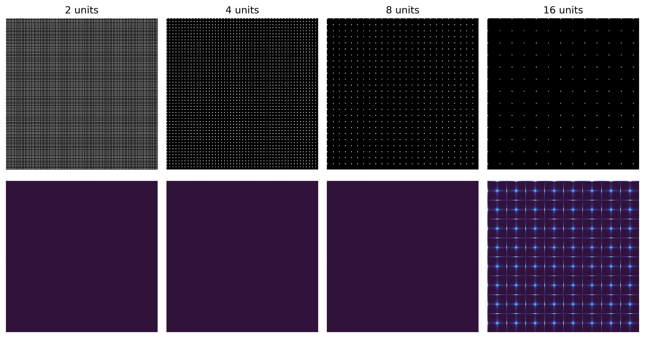
APP PHYSICS 157
PROPERTIES AND APPLICATIONS OF THE 2D FFT
More point patterns in space
Figure 15. FFTs of equally spaced dots along the grid for varying spacing values.
It can be observed that for very tight spacing, the dot pattern approaches the appearance of a sinusoid in the Fourier domain. As the spacings become more distant, the resulting pattern of the Fourier transform is a pattern of dots with narrower spacing. This can be interpreted as a superposition of many sines that destructively interfere in the right places to form the appearance of a dot in the grids.

Slide 20
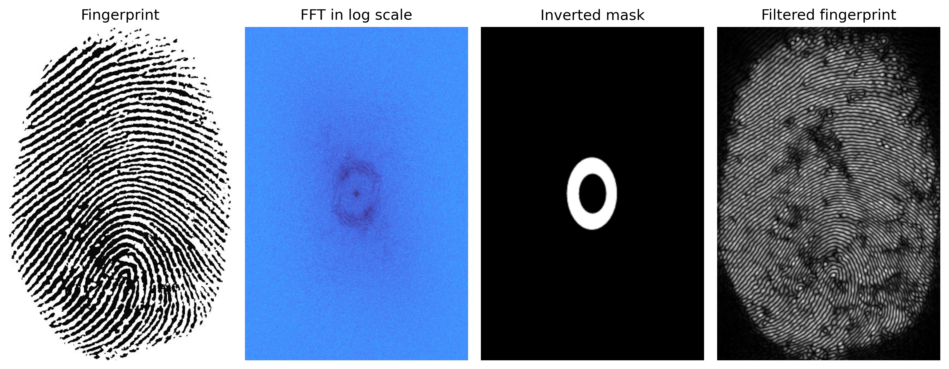
APP PHYSICS 157
PROPERTIES AND APPLICATIONS OF THE 2D FFT
Fingerprint ridge enhancement
Figure 16. FFTs of equally spaced dots along the grid for varying spacing values.
It can be seen that a bunch of high-intensity spots in an ellipse form around the center of the Fourier domain. These are most likely the components we can safely erase since they are of relatively low frequency. Note that the point peak at the center or near the origin was not masked as it is highly likely the information that separates the actual fingerprint from the background is contained here. The results can further be improved by creating a better mask to ensure the filtering of unwanted peaks in the frequency space. Also, the mask was inverted since we are only concerned on the pattern itself, which is similar to what was done in the canvas weave modelling activity!

Slide 21
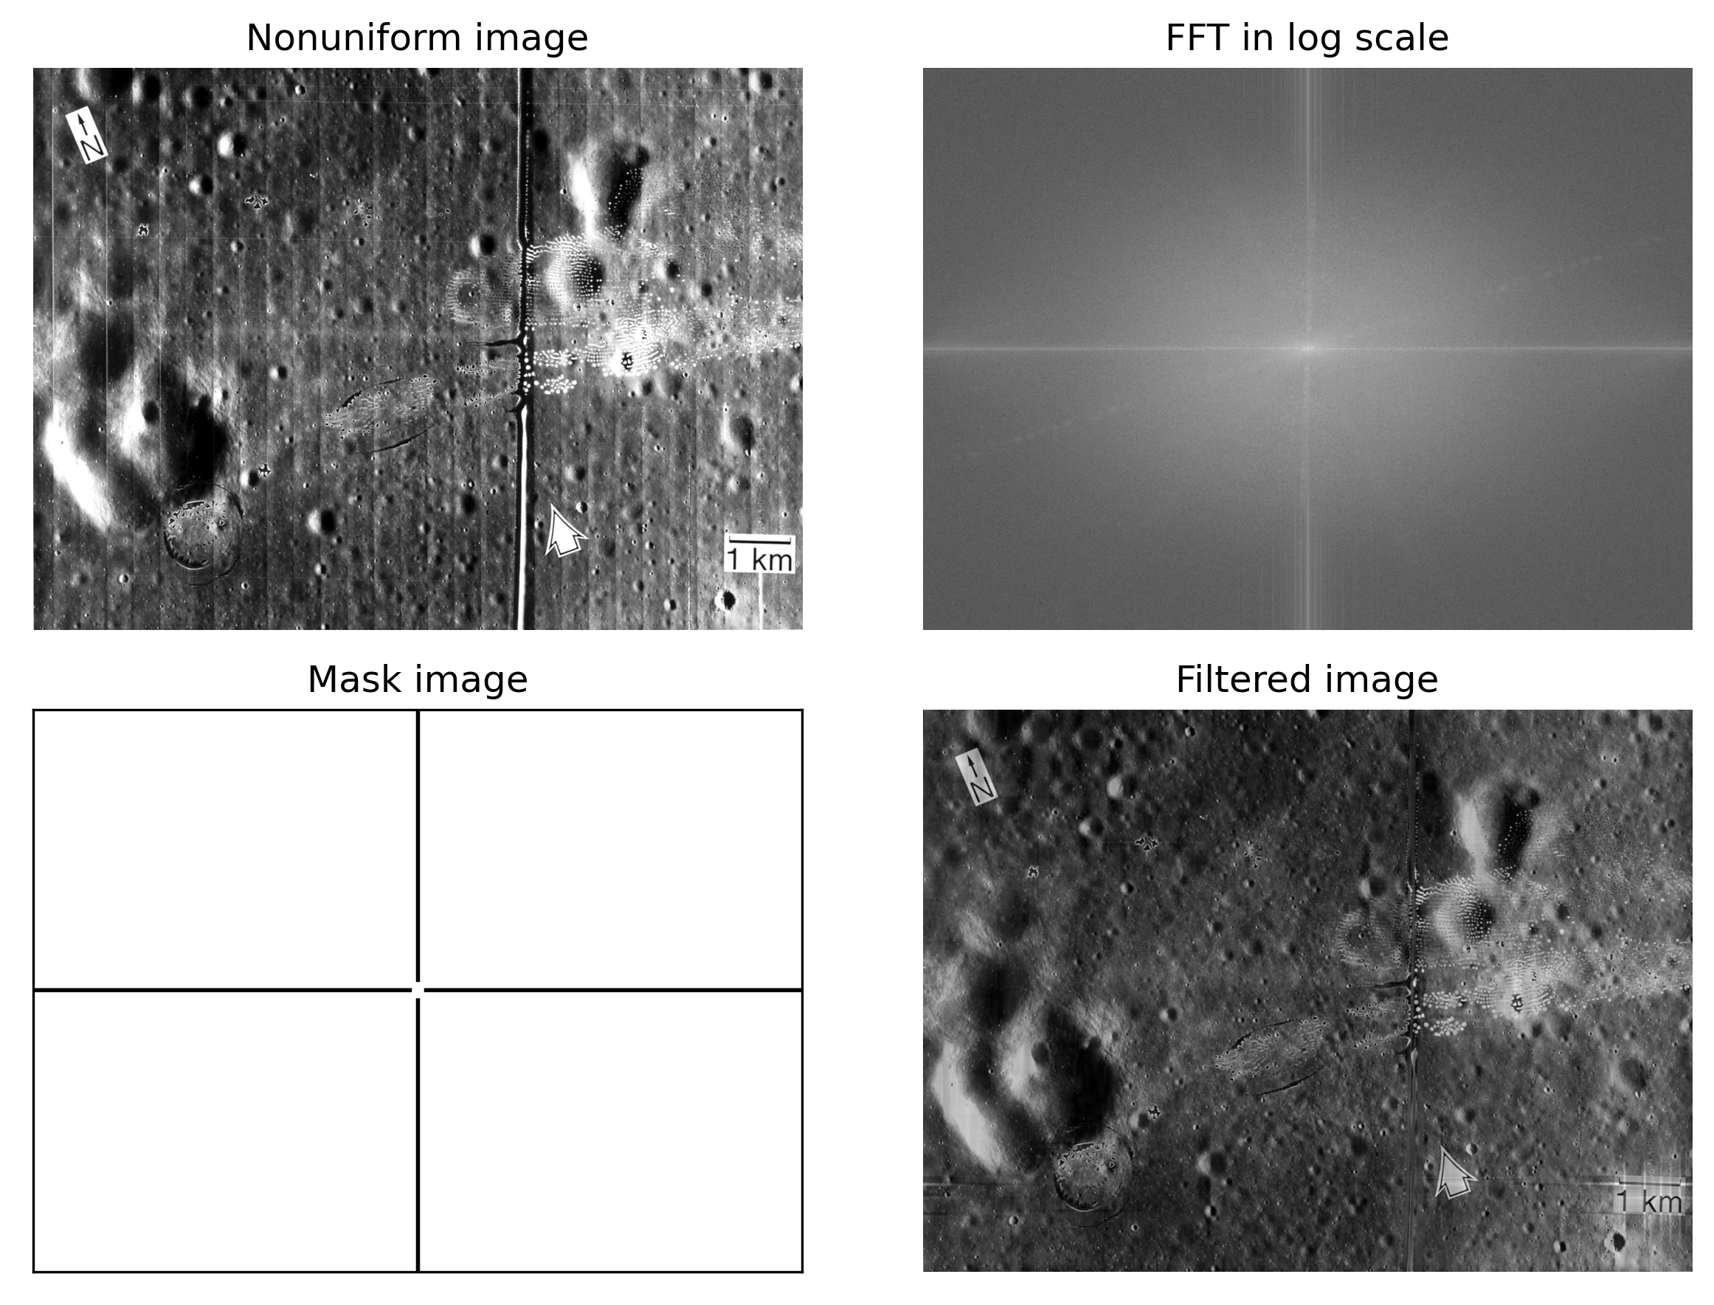
APP PHYSICS 157
PROPERTIES AND APPLICATIONS OF THE 2D FFT
Lunar landing scanned pictures
Figure 17. Results of the lunar landing scanned pictures after filtering in the Fourier domain.

Slide 22
APP PHYSICS 157
PROPERTIES AND APPLICATIONS OF THE 2D FFT
Lunar landing scanned pictures
It can be observed from the original image that the regularly spaced vertical lines are the result of combining individually digitized framelets to take a composite photograph, and the irregularly-shaped bright and dark spots are due to nonuniform film development. These can be filtered out by using what we have learned in the previous activities on canvas modelling and ridge enhancements!
Upon examining the rotation properties of Fourier transform, lines in the spatial domain are usually rotated by 90 degrees when represented in the frequency domain. Thus, we can safely mask out the horizontal line in the Fourier transform excluding the frequencies at/near zero to get rid of the vertical lines in the original image! The vertical line in the mask were added to clean further our image – this eventually erased the bright horizontal line along the center of the image, as It should!

Slide 23
APP PHYSICS 157
PROPERTIES AND APPLICATIONS OF THE 2D FFT
REFLECTION
I find the activity generally fun since it covers some of the real-world applications of Fourier Transform, which I really look forward to since it transcends beyond the what was taught in the lectures. I was also able to compare the differences of my results to what the theory suggests, specially on the activity on the convolution theorem redux since I was able to revisit some concepts I have picked up on the previous activities in the class. Overall, I would give myself a score of 110/100. Yay.
REFERENCES | GITHUB
M. Soriano, Applied Physics 157 – Properties and application of the 2D Fourier transform, 2023.
White Balancing — An Enhancement Technique in Image Processing

